Slide 1
Sumo Team A Team 8
Robotics Competition
Hunter Lane, Graham Rose, Sean Sussman, Jordan Ziegler
April 28th, 2017

Slide 2
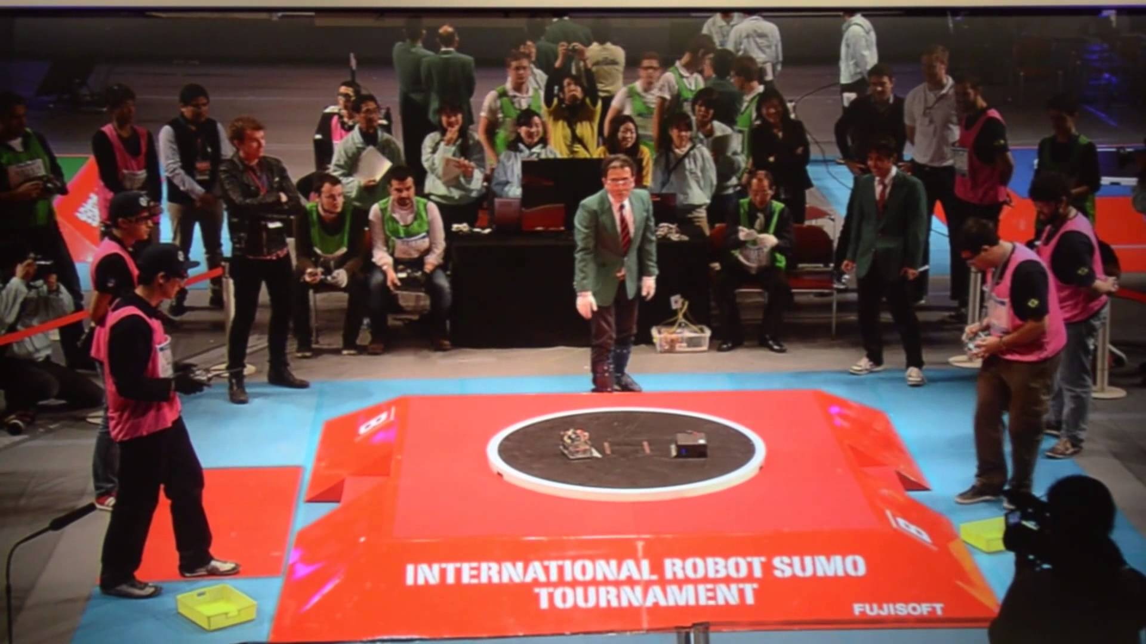
Project Description
Head-to-head match following traditional human sumo matches
Pushing match only; no weapons, no flipping, no jamming, no projectiles, no liquids
Three design tasks
Remote controlled mega sumo
Autonomous mega sumo
Additional showcase design
Showcase design chosen was
a 10-pound combat shell
4/28/17, Jordan Ziegler, Slide 2

Slide 3
Project Requirements
Requirements are limited, creativity is highly encouraged
Sumo Specifications
Autonomous control must be fully contained, receive no external signals
RC motion directly due to teleoperation of the operator
Combat Specifications
No size requirements
Tethered projectiles only, no liquids, no damaging the arena
School Restrictions – No projectiles, no flames
4/28/17, Jordan Ziegler, Slide 3

Slide 4
Project Requirements – Engineering Requirements
Customer Needs generated using official competition rules
Engineering Requirements generated using Customer Needs
Same requirements for all competitions
4/28/17, Sean Sussman, Slide 4

Slide 5
Design Solution - Overview
Final Design includes two Designs
A single sumo robot capable of remote and autonomous control
A wedge-style combat shell, using same internal components as sumo
4/28/17, Sean Sussman, Slide 5

Slide 6
Design Solution – Mechanical Components
High speed, high torque Maxon Motors: 15V, 7180-rpm, 73.1-mNm of Torque
Two wheel design: 65 shore A hardness to maximize friction, minimize impact shock
4/28/17, Hunter Lane, Slide 6

Slide 7
Design Solution – Mechanical Components
Hardened steel gears: 3-stage 6,4:1 reduction ratio
6 neodymium magnets to increase downward force
4/28/17, Hunter Lane, Slide 7

Slide 8
Design Solution – Electrical Components
Sabertooth 2x32 Dual-Speed-Controller
Supply 15-30V and 32 Amps per channel
Reads RC & autonomous inputs
Arduino Uno for Autonomous Control
4/28/17, Graham Rose, Slide 8

Slide 9
Design Solution – Electrical Components
2 Pepperl+Fuchs infrared sensor for opponent detection
4 QTR1A contrast sensors for edge detection
Lithium polymer battery: 30C, 2200mah
4/28/17, Graham Rose, Slide 9

Slide 10
Manufacturing – Sumo Frame
Frame constructed with 1/8th-inch mild steel, 28-gauge galvanized steel plates
Frame pieces attached with tack welds
steel plates are attached with JB weld
Electronics held in 3D-printed housing
Gears used as a 2-stage reduction
Mounted on 1/4th-inch stainless steel rods
4/28/17, Hunter Lane, Slide 10

Slide 11
Manufacturing – Combat Shell
Frame constructed with 1/4th-inch aluminum
3D-printed internal components for electronics mounting
4/28/17, Sean Sussman, Slide 11

Slide 12
Manufacturing – Electronical Circuit
Speed Controller
Opponent
Sensors
Motors
Edge
Sensors
Battery
Microcontroller
4/28/17, Graham Rose, Slide 12

Slide 13
Manufacturing - Programming
Autonomous functionality programmed in the Arduino Sketch Language
Arduino uses Pulse-Width-Modulation (PWM) signals ranging from 0-5Volts to control the motors
4/28/17, Graham Rose, Slide 13

Slide 14
Testing Proofs
8 tests conducted to ensure final designs met all Engineering requirements
4/28/17, Hunter Lane, Slide 15

Slide 15
A special thank you to…
Tom Cothrun for his assistance modifying hardware and assistance in shaft/gear mounting
Dr. John Sharber for his assistance in designing the electrical circuit
The NAU Baja Team for their material donations

Slide 16

Sponsors

Slide 17
References
[1] “Unified Sumo Robot Rules”, Robotgames.net. 2016, Web. 25 Sept 2016.
[2] Massachusetts Institute of Technology, “Sumo Robots,” MITMECHE. Dec 2014.
[3] motors and drive systems | maxon motor", Maxonmotorusa.com, 2016. [Online]. Available: http://www.maxonmotorusa.com/maxon/view/content/index. [Accessed: 23- Nov- 2016].
[4] F. Dede, "How to Make a Sumo Robot", Jsumo.com, 2016. [Online]. Available: https://jsumo.com/how-to-make-sumo-robot/. [Accessed: 23- Nov- 2016].

Slide 18
Questions?

Slide 19
Manufacturing - Programming
4/28/17, Graham Rose, Slide 14

